Slide 1
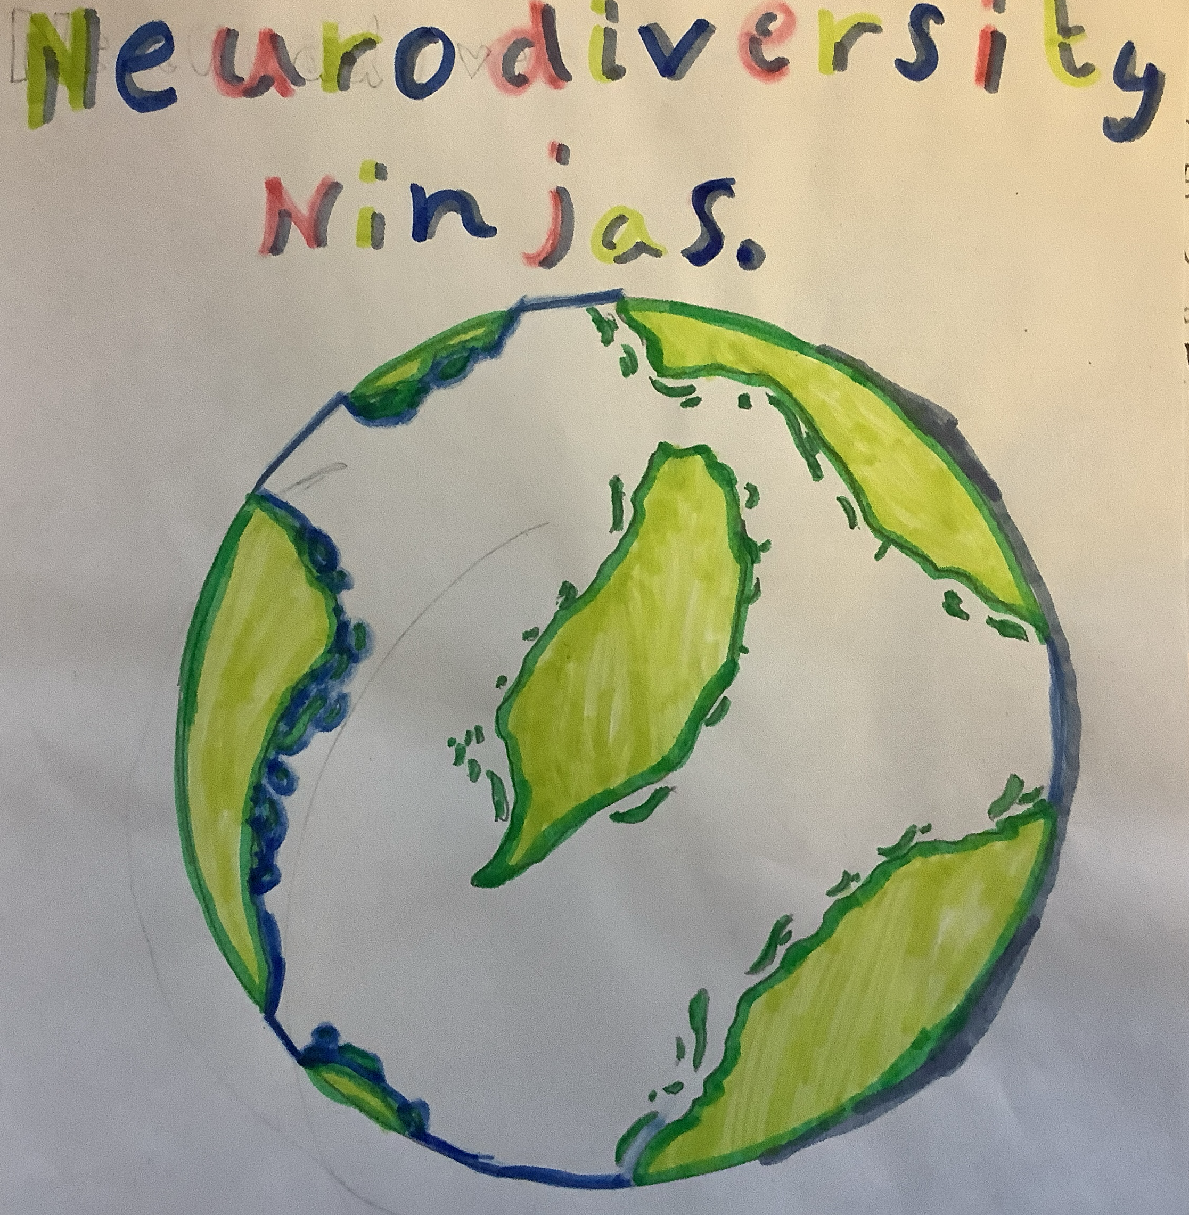
Exploring Neurodiversity
By the Neurodiversity Ninjas

Slide 2
What do you think neurodiversity means?

Slide 3
Neurodiversity is…
A range of different brain functions.
Some people may find it harder to learn in certain ways than others.
It means that everyone’s mind is different and some people learn differently and use different ways to help them.
It might mean people find it harder to concentrate and loud noises might be difficult to handle

Slide 4
Why is it important to learn about neurodiversity?

Slide 5
Neurodiversity is important to learn about because…
It’s important to know about how everyone is different
Helps people feel valued for who they are
It helps people learn that other people can act differently
Everyone is unique in their own way and it is not wrong to be different

Slide 6
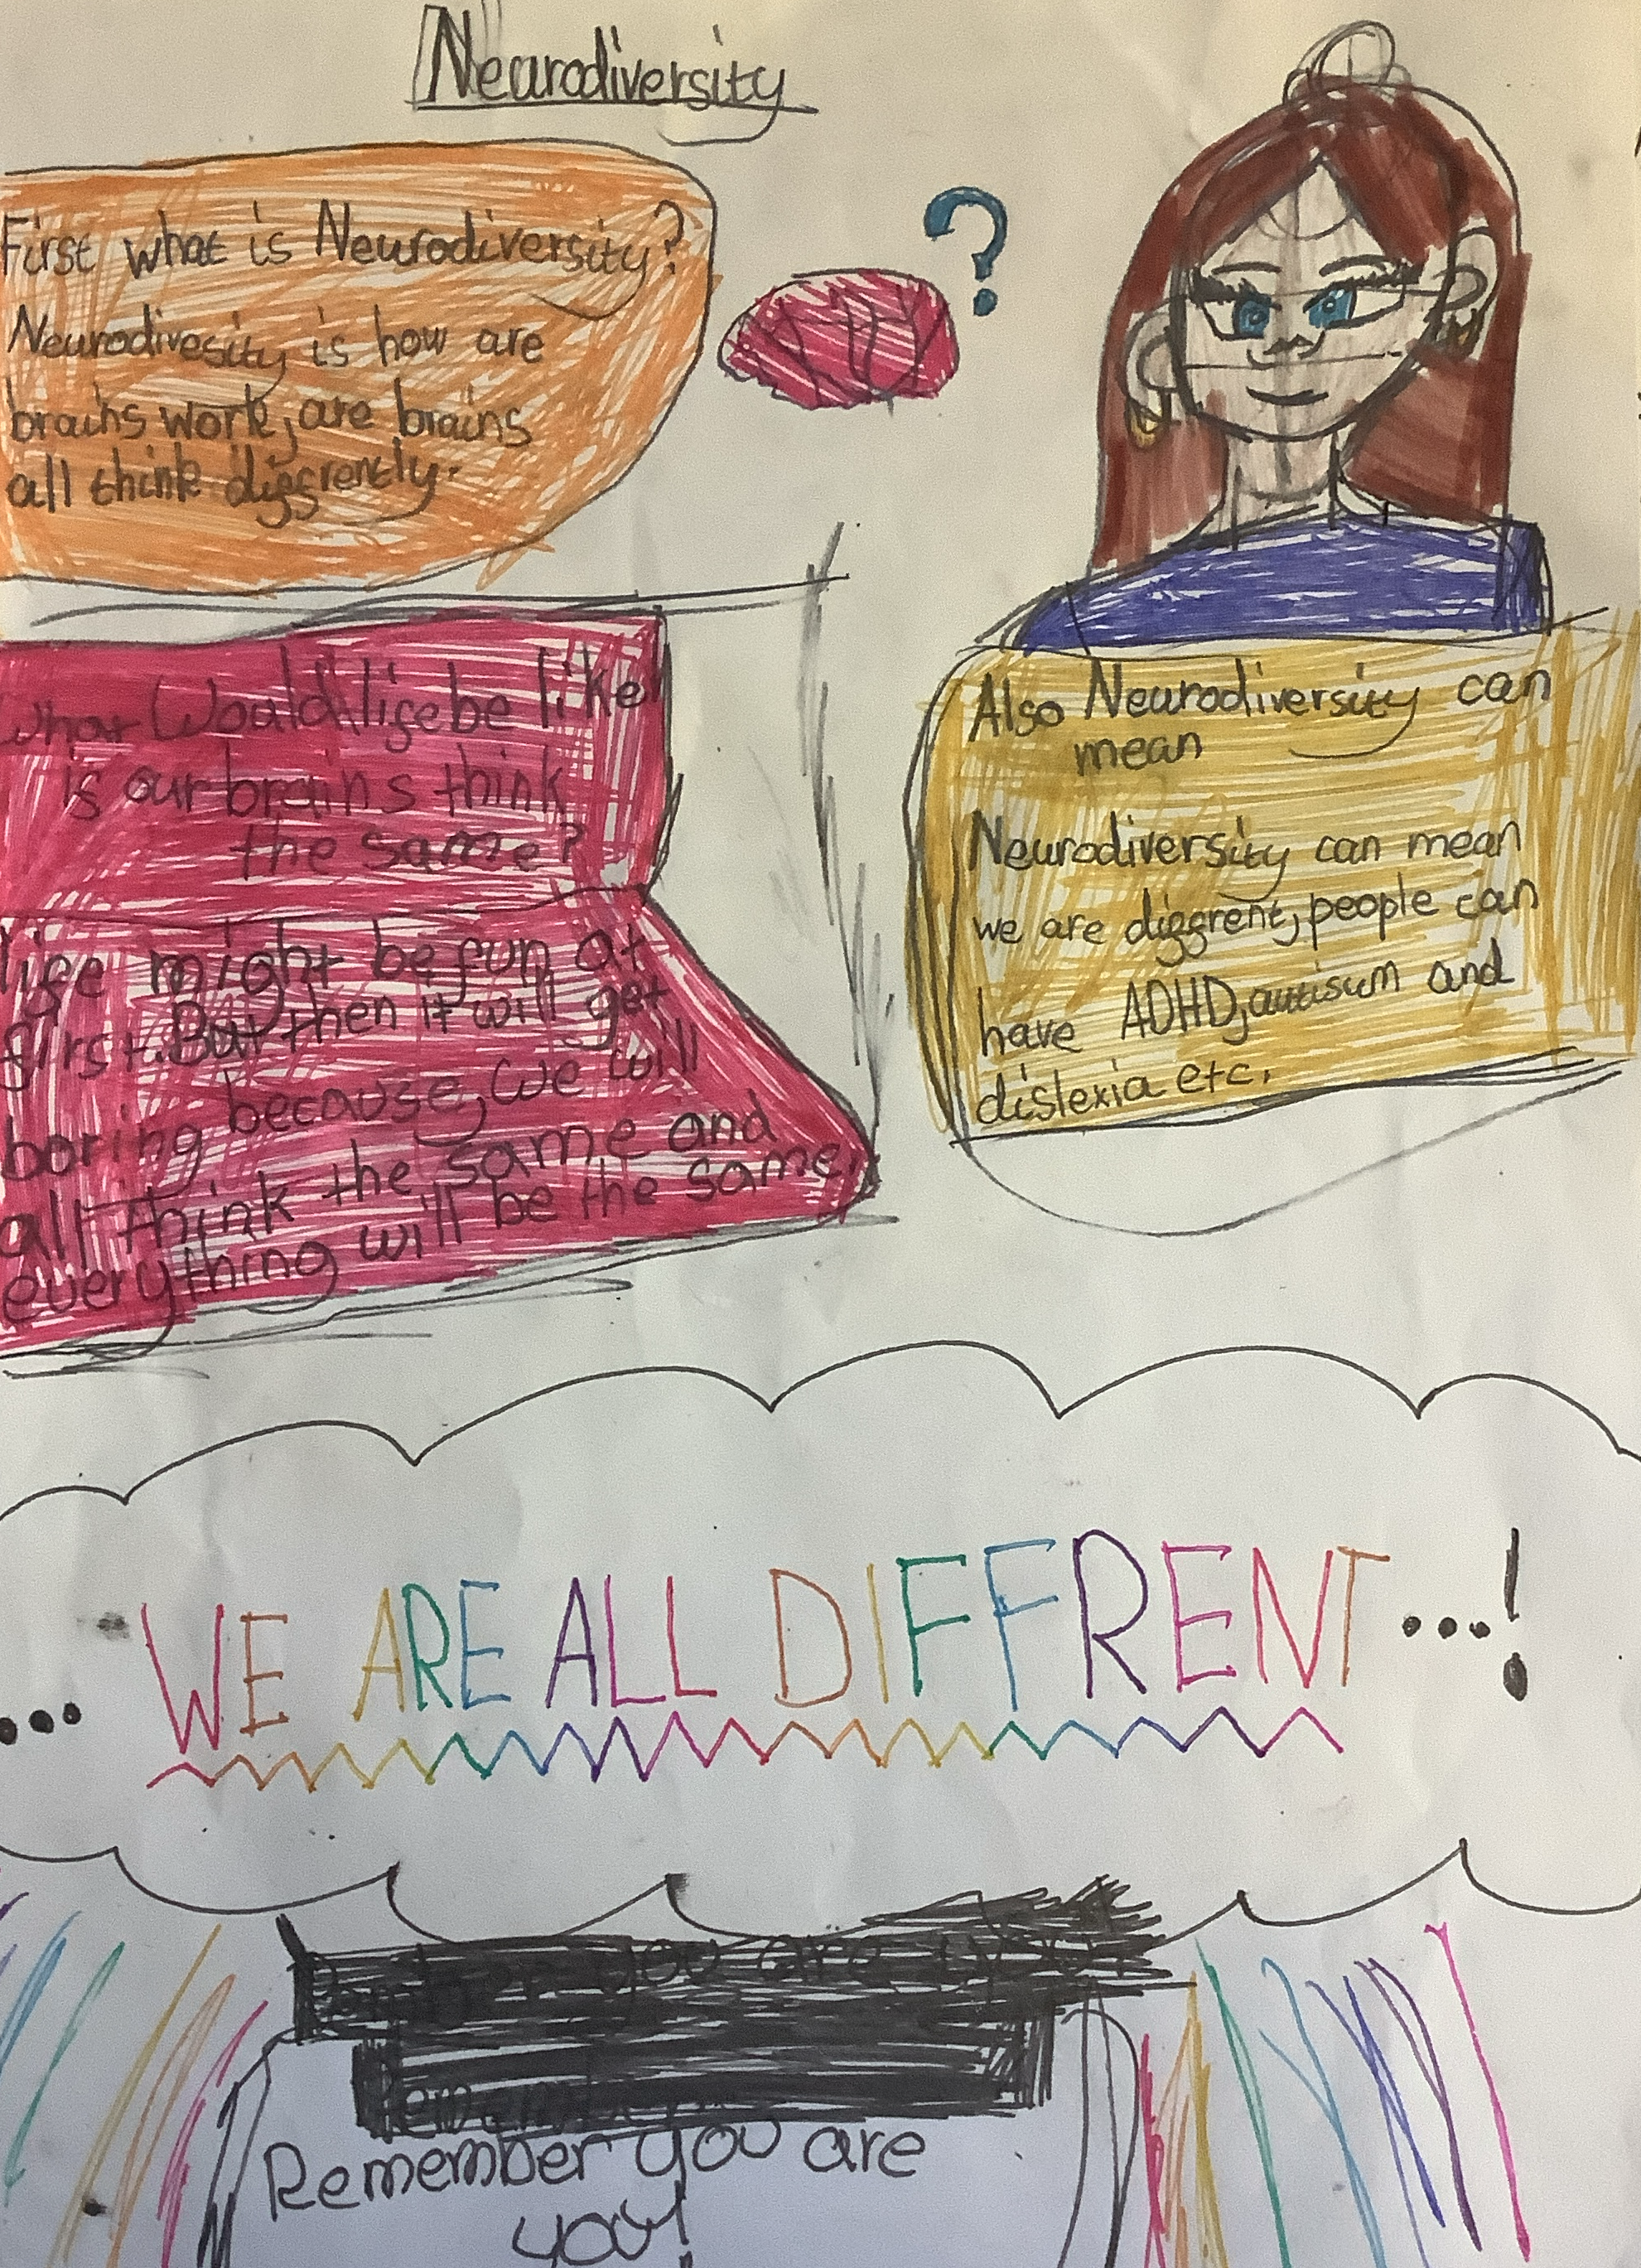

Slide 7
‘The world needs all kinds of minds.’
–Dr Temple Grandin

Slide 8
Types of Neurodiversity
ADHD
Dyslexia
Autism
Tourette’s Syndrome
Dyspraxia
Dyscalculia

Slide 9
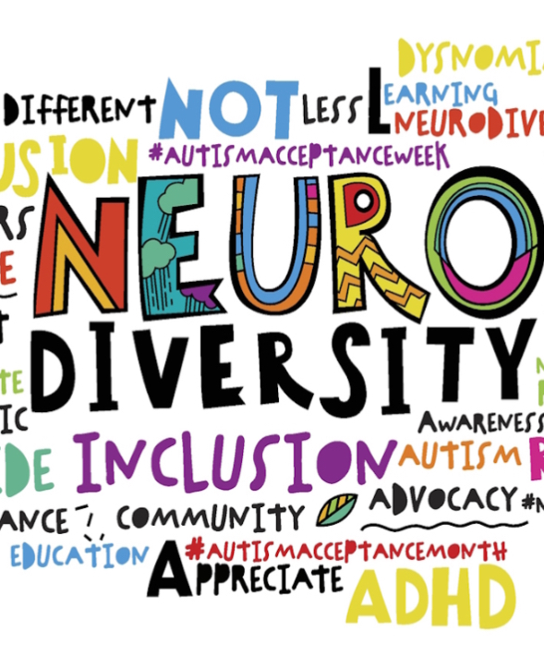
Famous Neurodivergent people

Slide 10
We are going to tell you about some celebrities who are neurodivergent to show that you can succeed at anything

Slide 11
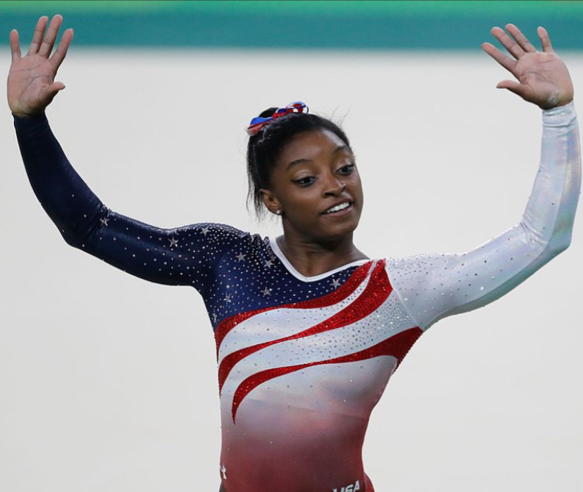
Simone Biles
Simone Biles has ADHD while being a Olympian gold medal gymnast. She won 7 Olympic medals.
She started gymnastics at 6 about 3 years before she was diagnosed.
She says that ADHD is her superpower instead of disability. She has taken medication for ADHD since she was Young.

Slide 12
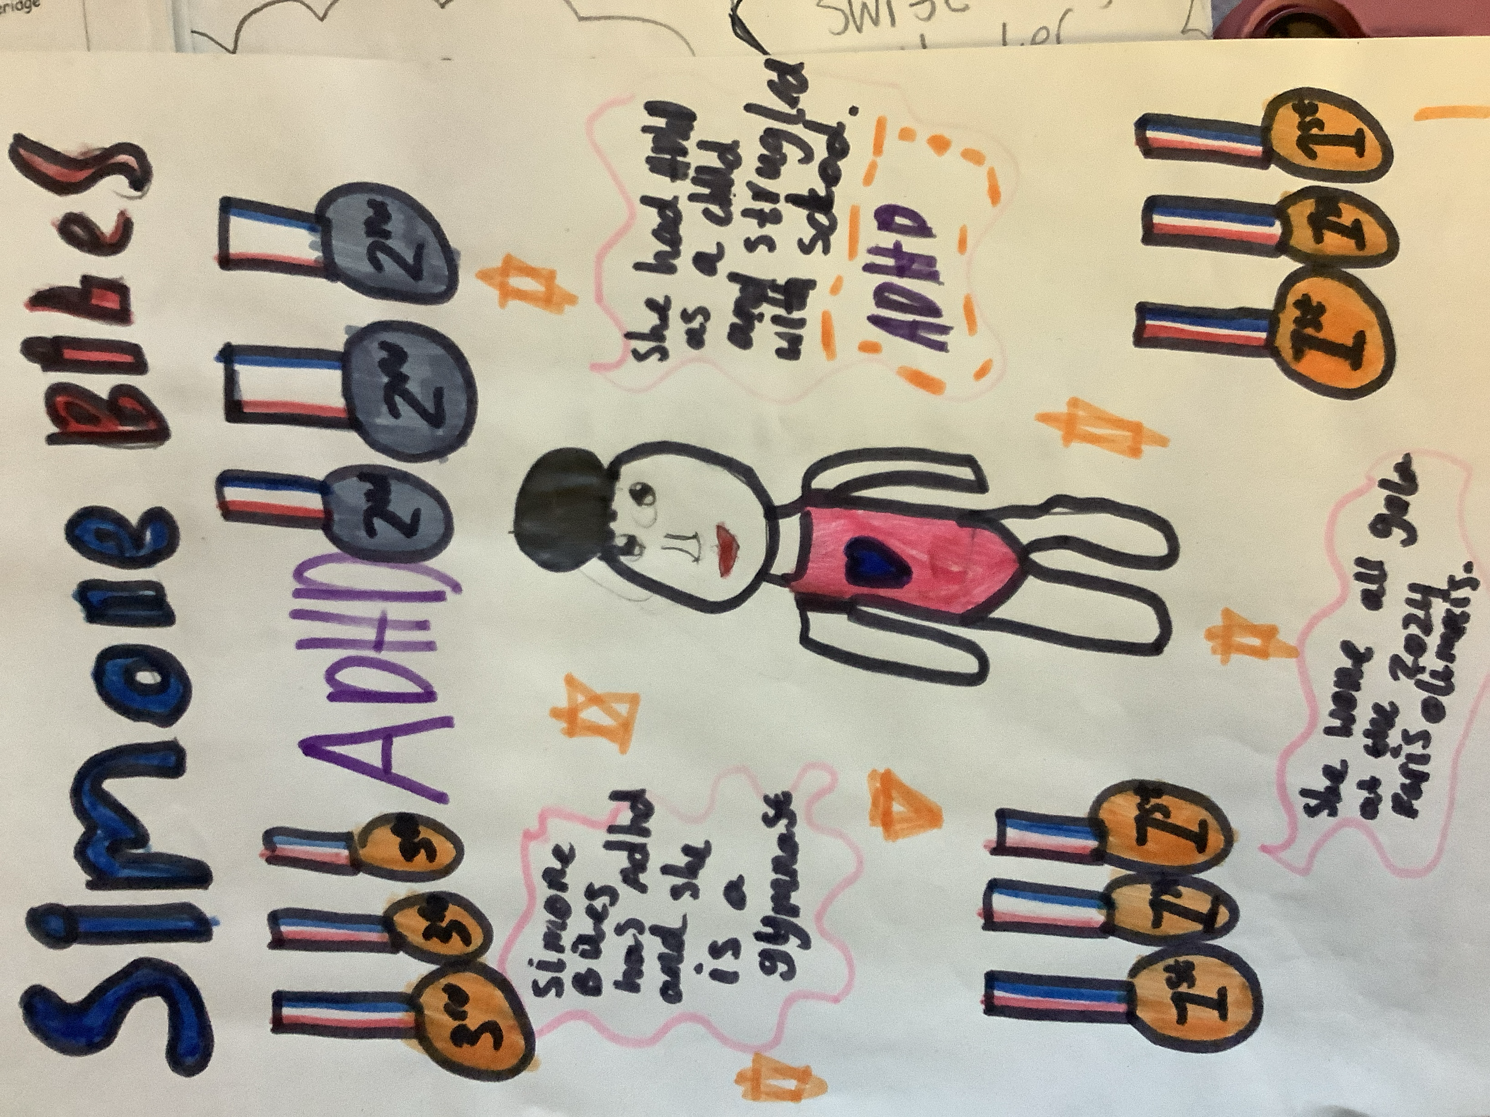

Slide 13
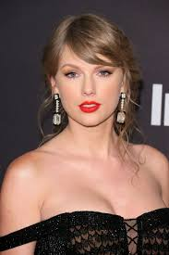
Taylor swift
Taylor finds reading and writing difficult when she was a kid because of dyslexia.
Despite her dyslexia, Taylor Swift is a very famous singer who has released 15 albums.

Slide 14
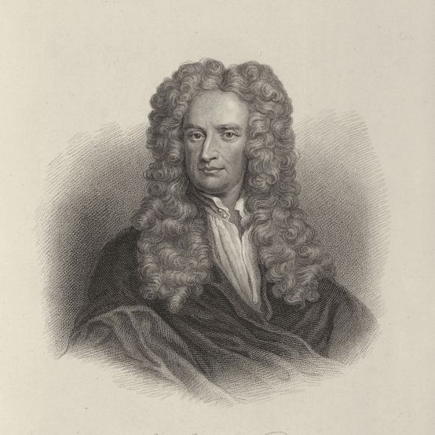
Issac Newton
He is a physicist famous for discovering gravity.
He’s also an author and mathematician.
He has a diagnosis of Autism and ADHD.
He was rigid in his routines. If no one showed up to lectures at Cambridge, he would lecture to an empty room anyway.

Slide 15
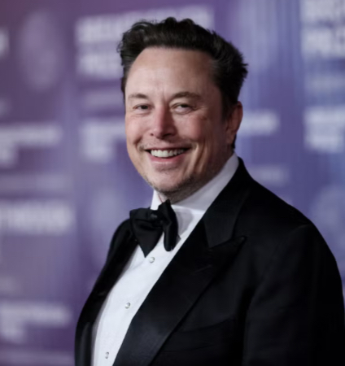
Elon Musk
Elon musk has autism.
He is known for Tesla, X and for being the richest man in the world.
He taught himself how to code at just 10.

Slide 16
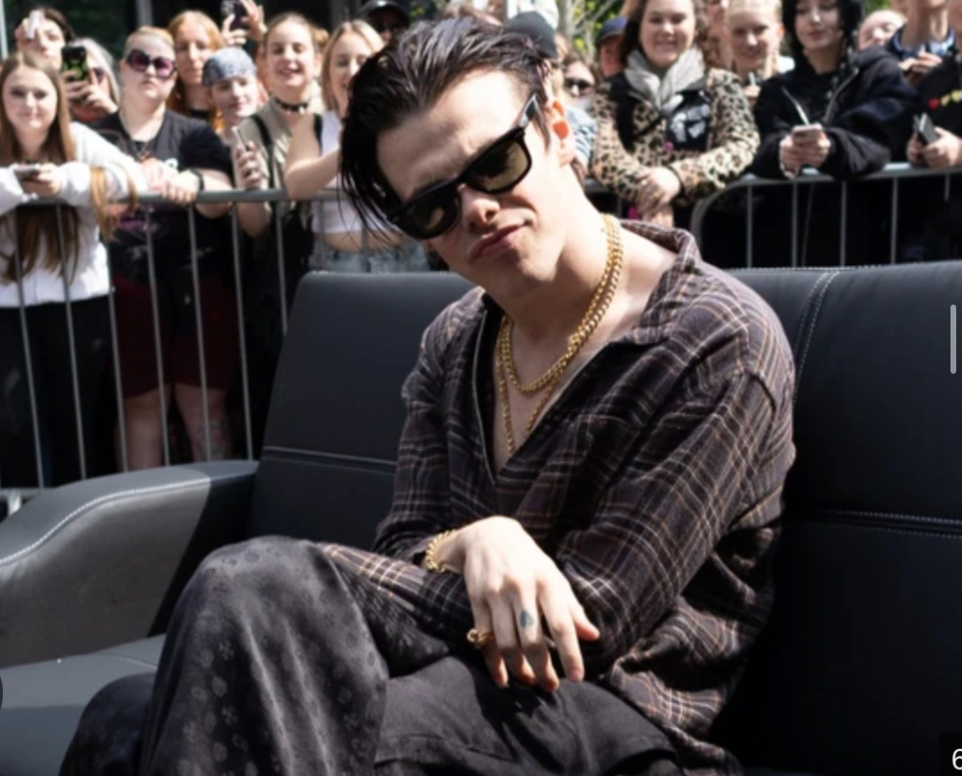
Yungblud
He struggles with ADHD.
He is a rock singer who was on the Disney channel.
He has 3 Grammy nominations.

Slide 17
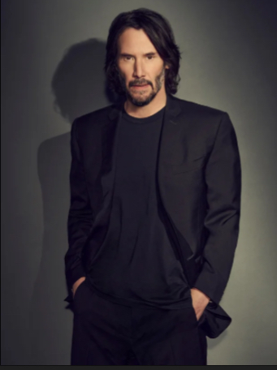
Keanu Reeves
He got famous from acting and is still an actor.
He got diagnosed with dyslexia when he was a kid.
He is very talented in acting and has been in lots of films such as the voice of Duke Caboom in Toy Story and Batman in DC League of Super-Pets
He has performed many of his own stunts when acting.

Slide 18
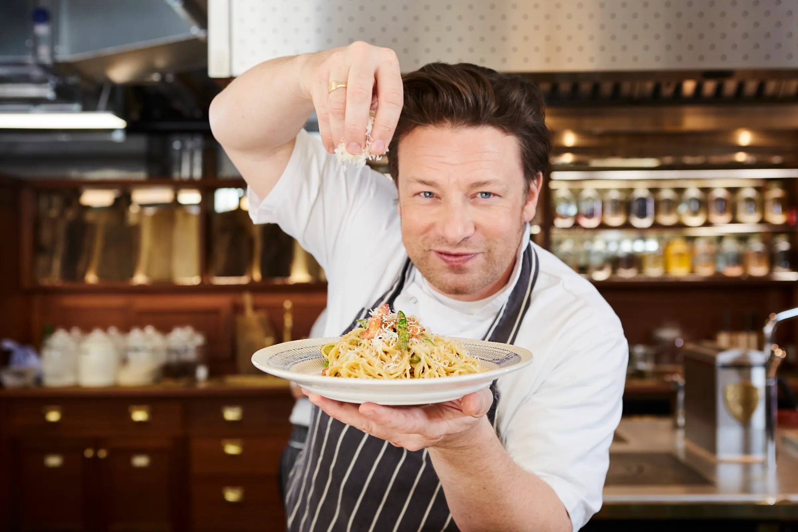
Jamie Oliver
Jamie Oliver is an award winning chef who writes cookbooks that have sold over 50 million copies.
He wants to make school dinners healthier and better, and has around 70 restaurants around the world.
He has dyslexia and has said “Being dyslexic is not an excuse or a reason for you not to prosper.”
He also says “Your weaknesses don’t define you and you can work around them to still find your place in the world.”

Slide 19
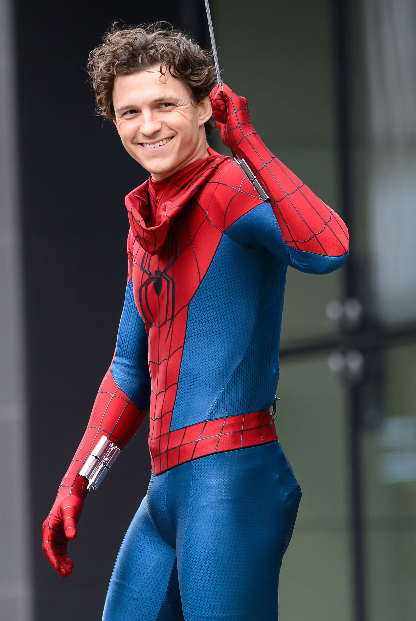
Tom Holland
Tom Holland is an actor famous for playing Spider-Man
He was diagnosed with ADHD and dyslexia at age 7
He is scared of spiders in real life

Slide 20
